Slide 1

This Photo by Unknown Author is licensed under CC BY-SA

Slide 2
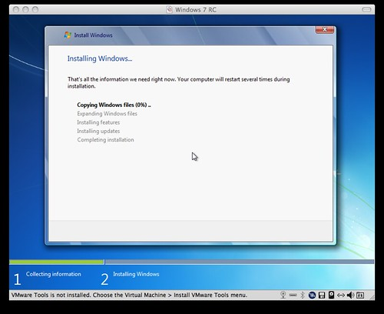
This Photo by Unknown Author is licensed under CC BY-SA

Slide 3
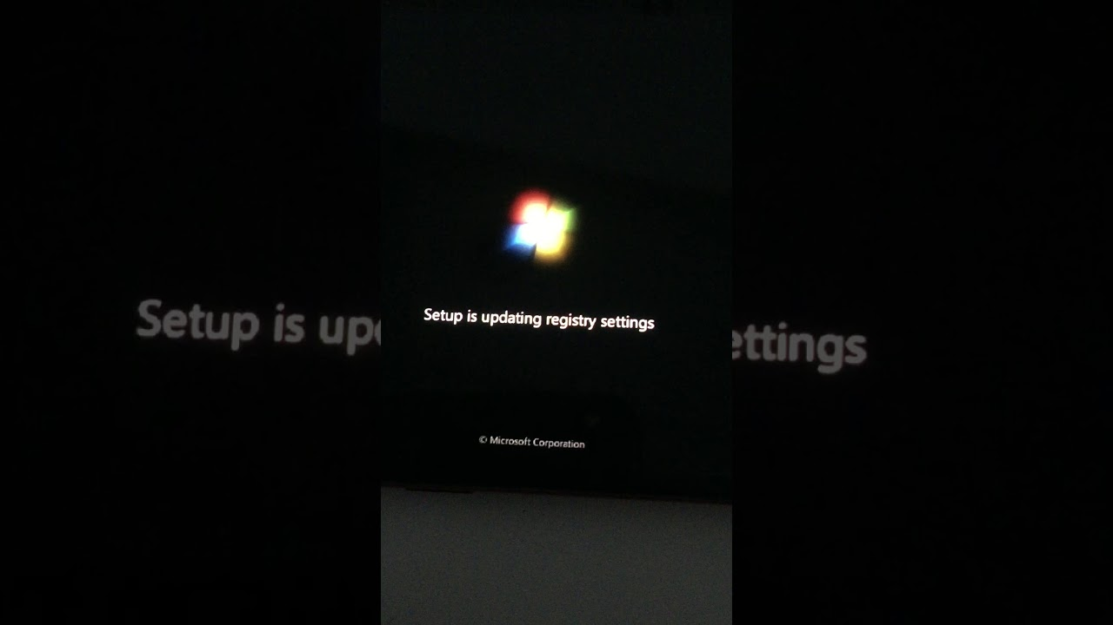

Slide 4
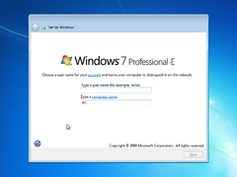
This Photo by Unknown Author is licensed under CC BY-SA

Slide 5
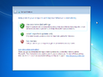
This Photo by Unknown Author is licensed under CC BY-SA

Slide 6
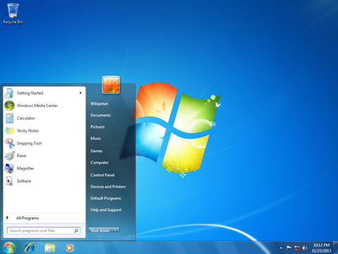
This Photo by Unknown Author is licensed under CC BY-SA-NC

Slide 7
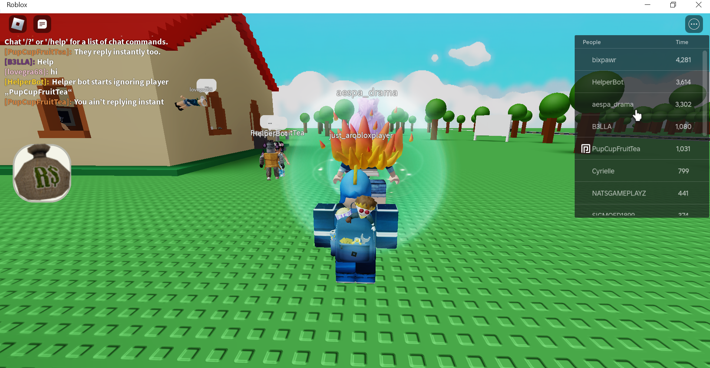
This Photo by Unknown Author is licensed under CC BY-SA-NC

Slide 8
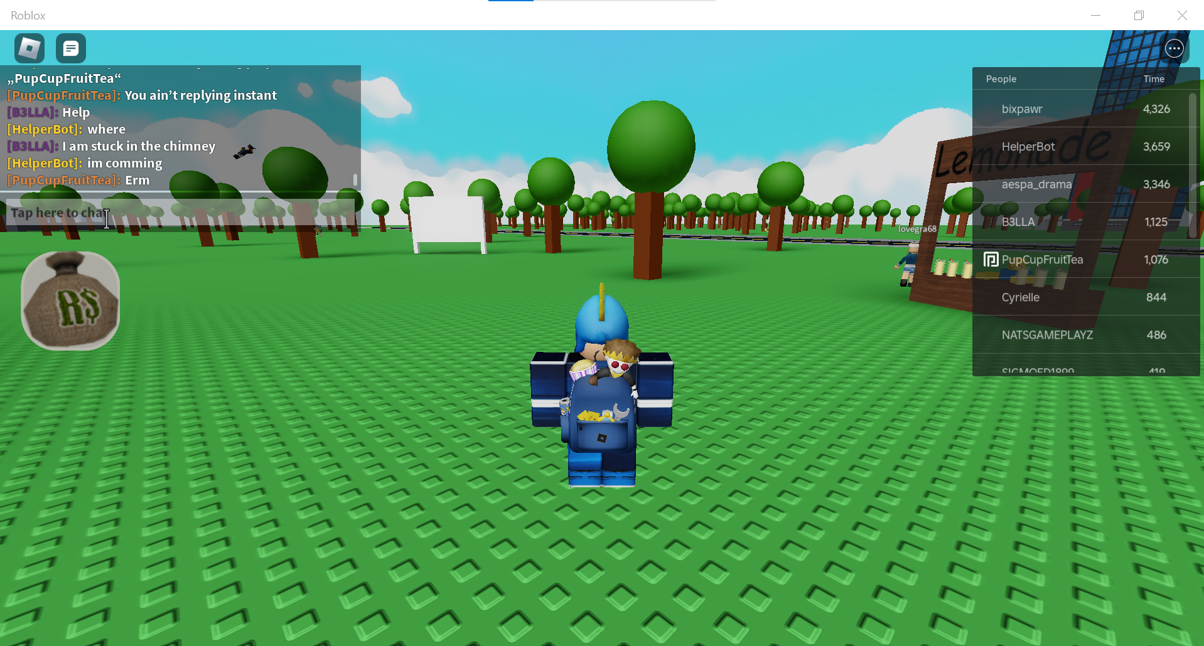
This Photo by Unknown Author is licensed under CC BY-SA-NC

Slide 9
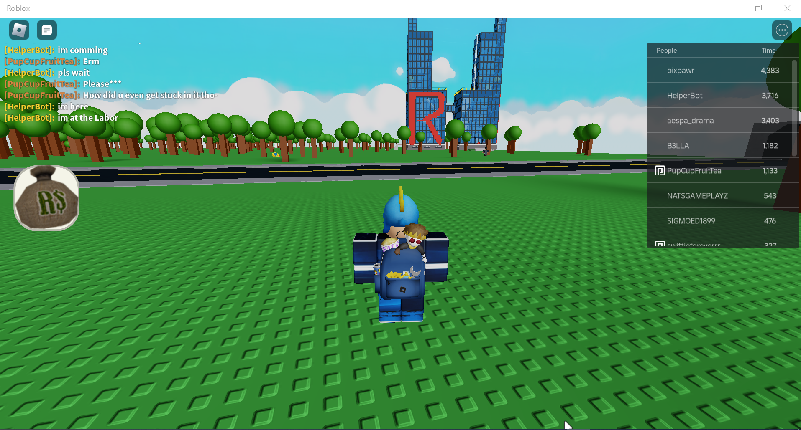
This Photo by Unknown Author is licensed under CC BY-SA-NC

